Slide 1
Introduction to Algorithms
BCA 202

Slide 2
Pre-Req
C – Pointers
C – Structures

Slide 3
Algorithms
Step by step procedure for calculations
an informal definition could be "a set of rules that precisely defines a sequence of operations.“
Takes some input and produces some sort of output
It is the fundamental object of study in CS

Slide 4
Why Study Algorithms?
Performance (related to user-friendliness)
Resource Usage
Time constraints
Feasible Vs Non-Feasible
Program Behavior

Slide 5
Name companies that excel in business because of excellent algorithms?
Notes:
Google, yahoo, amazon

Slide 6
What’s more important than Performance?
Correctness
Simplicity
Maintainability
Cost (what type? – programmer type)
Stability / robustness
Features (functionality)
Modularity (ability to conduct changes to code)
Security (of late!)
Sometime performance is correlated with user friendliness – feasible Vs Infeasible

Slide 7
Why study Analysis?
Performance is the basis of many things!
Use it to pay for other things we want
The universal thing that you quantify
What is the goal of analysis of algorithms?
To compare algorithms mainly in terms of running time but also in terms of other factors (e.g., memory requirements, programmer's effort etc.)
What do we mean by running time analysis?
Determine how running time increases as the size of the problem increases.

Slide 8
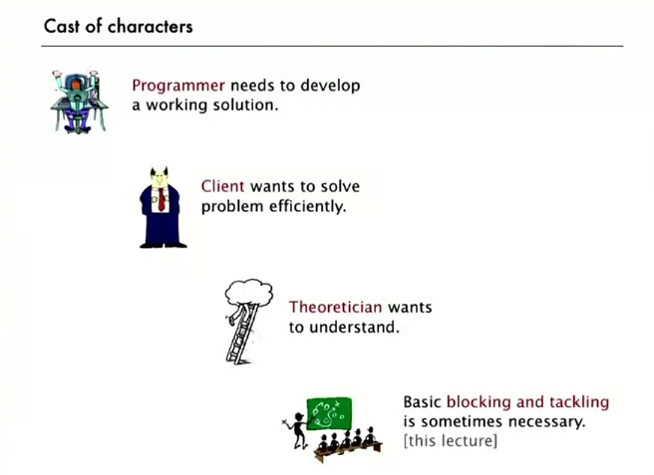
Different Views

Slide 9
Input
Input size (number of elements in the input)
size of an array
polynomial degree
# of elements in a matrix
# of bits in the binary representation of the input
vertices and edges in a graph

Slide 10
Example of a Sort
11 | 3 | 6 | 4 | 7 | 10 | 1
Input array
3 | 11 | 6 | 4 | 7 | 10 | 1
3 | 6 | 11 | 4 | 7 | 10 | 1
3 | 4 | 6 | 11 | 7 | 10 | 1
3 | 4 | 6 | 7 | 11 | 10 | 1
3 | 4 | 6 | 7 | 10 | 11 | 1
1 | 3 | 4 | 6 | 7 | 10 | 11
Sorted array

Slide 11
Parameters
Execution time – factors
Depends on input condition of the array
E.g. sorted array easier, reverse sorted difficult
Upper bound times more important than lower bound
Service levels (guaranteed times)

Slide 12
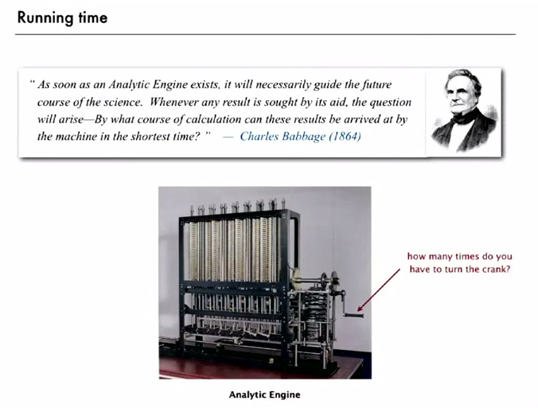

Slide 13
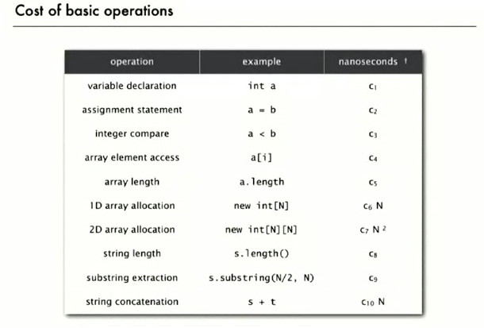

Slide 14
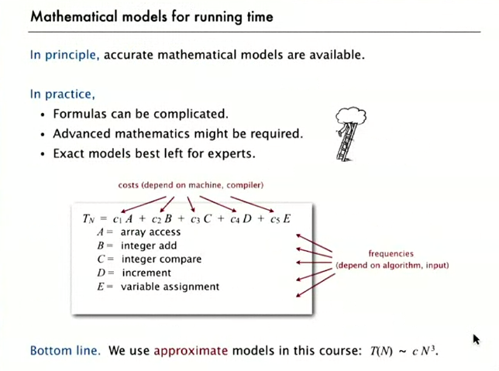

Slide 15
Kinds of analysis
Worst case analysis
Provides an upper bound on running time
An absolute guarantee that the algorithm would not run longer, no matter what the inputs are
T(n) represents max cost (time) on any input
It is a relation (not a function)
Average case
Provides a prediction about the running time
Assumes that the input is random
T(n) is the expected time of all inputs of size n
Best case (inflated?!)
Provides a lower bound on running time
Input is the one for which the algorithm runs the fastest

Slide 16
How do you compare?
A few objective measures
Compare execution times?
But they are specific to a particular computer, RAM, CPU’s etc.
Number of statements?
They are dependant on programmer, language, etc
Express as a function of the input size n (i.e., f(n))?
Compare different functions corresponding to running times
Quite Independent?
Asymptotic analysis
Ignore machine dependency
Look at growth of running time as a relation to n

Slide 17
Example of metrics
Two Algorithms – A & B
Number of steps shown alongside for each Algorithm
Size is the number of elements for processing
Size | #Steps-A | #Steps-B
1 | 34 | 1220
2 | 60 | 2420
3 | 110 | 3620
4 | 196 | 4820
5 | 330 | 6020
6 | 524 | 7220
7 | 790 | 8420
29 | 49146 | 34820
30 | 54380 | 36020
31 | 59974 | 37220
32 | 65940 | 38420
33 | 72290 | 39620
34 | 79036 | 40820
35 | 86190 | 42020
36 | 93764 | 43220
37 | 101770 | 44420
38 | 110220 | 45620

Slide 18
Comparison
two different algorithms
Number of steps as per formulae below
F1() = 2x³ + 12x + 20
F2() = 1200x + 20
Which is better?
What if they are run in slower speeds
Notes:
Even if they are run on different computer speeds…
Maths + engg… (use when relevant and when not)

Slide 19
Visualize this
as you go to the right, a faster growing function eventually becomes larger...
Increasing value of function →
chess
Increasing n →

Slide 20
Asymptotic Analysis
To compare two algorithms with running times f(n) and g(n), we need a rough measure that characterizes how fast each function grows.
Compare functions in the limit, that is, asymptotically (i.e., for large values of n)
In asymptotic sense estimate the complexity function for arbitrarily large input.
Big O notation, omega notation and theta notation
For instance, binary search is said to run in logarithmic time - a number of steps proportional to the logarithm of the length of the list being searched,
O(log(n))
Class of functions

Slide 21
Some basic background
Main metric in algorithms is speed (or number of steps)
How to measure speed?
Operations relative to input
Input size (n)
Growth in operations in terms of (n)
3 asymptotic bounds
Big-O Notation
Big-Omega
Big-Theta
Relate the growth of one function relative to another

Slide 22
Asymptotic Notation
Characterize an algorithm as a function of the “problem size”
E.g.
Input data = array → problem size is N (length of array)
Input data = matrix → problem size is N x M
Goal: to simplify analysis by getting rid of unneeded information (like “rounding” 1,000,001≈1,000,000)
We want to say in a formal way 3n² ≈ n²
The “Big-Oh” Notation:
given functions f(n) and g(n), we say that f(n) is O(g(n)) if and only if there are positive constants c and n₀ such that f(n)≤ c g(n) for n ≥ n₀

Slide 23
Graphic Illustration
f(n) = 2n+6
Conf. def:
Need to find a function g(n) and a const. c such as f(n) < cg(n)
g(n) = n and c = 4
→ f(n) is O(n)
The order of f(n) is n
c g
n
(
n
)
=
4
g
n
(
n
)
=
n

Slide 24
Examples
What about f(n) = 4n² ? Is it O(n)?
Find a c such that 4n² < cn for any n > n0
50n³ + 20n + 4 is O(n³)
Would be correct to say is O(n³+n)
Not useful, as n³ exceeds by far n, for large values
Would be correct to say is O(n⁵)
OK, but g(n) should be as closed as possible to f(n)
3log(n) + log (log (n)) = O( ? )
Simple Rule: Drop lower order terms and constant factors

Slide 25
Asymptotic analysis - terminology
Special classes of algorithms:
logarithmic: O(log n)
linear: O(n)
quadratic: O(n²)
polynomial: O(n^{k}), k ≥ 1
exponential: O(a^{n}), n > 1
Polynomial vs. exponential ?
Logarithmic vs. polynomial ?

Slide 26
Some Numbers

Slide 27
Analogies
Big – O | <=
Big Omega Ω | >=
Big Theta Θ | =
Small Omega ῳ | >
Small – o | <
F(n) = O (g(n)) | F(n) is in some set of functions like G. Means in the set (Є) O(g(n)) = { f(n) : there are constants c > 0, n₀ > 0 and 0 < f(n) <= g(n) for all n > n₀} (i.e.) growth rate of F(n) is no more than that of g(n) | Useful for upper bounds
Omega Ω | >=
Theta Ѳ | =
Omega ῳ | >
Small – o | <
Notes:
Ѳ

Slide 28
A Few examples
n⁴ + 100n² + 10n + 50 is O(n⁴)
10n³ + 2n² is O(n³)
n³ - n² is O(n³)
constants
10 is O(1)
1273 is O(1)

Slide 29
An Example of comparison
Algorithm 1 | Algorithm 2 | Algorithm 3
c₁+c₁+...+c₁ = c₁ x N | (N+1) x c₂ + N x c₁ = (c₂ + c₁) x N + c₂ | c₁ + c₂(N+1) + c₂N (N+1) + c₃N²
order: O(N) | order: O(N) | O(N²)
Step | Cost
arr[0] = 0; | c₁
arr[1] = 0; | c₁
arr[2] = 0; | c₁
…
arr[n] = 0; | c₁
Step | Cost
sum = 0; | c₁
for(i=0; i<N; i++) | C₂
for(j=0; j<N; j++) | C₂
sum += arr[i][j]; | C₃
Step | Cost
for(i=0; i<N; i++) | c₂
arr[i] = 0; | c₁

Slide 30
Big O
Relative and absolute speed
E.g. consider 10x⁴ + 7x³ + 20x² + 1. This is considered Theta of 4 since the other exponents become insignificant for large x
big O notation is used to describe (in a simplified way) the limiting behaviour of a function when the argument tends towards a particular value (infinity)
In typical usage, the formal definition of O notation is not used directly; rather, the O notation for a function f(x) is derived by the following simplification rules:
If f(x) is a sum of several terms, the one with the largest growth rate is kept, and all others omitted.
If f(x) is a product of several factors, any constants (terms in the product that do not depend on x) are omitted.
A description of a function in terms of big O notation usually only provides an upper bound on the growth rate of the function.
several related notations, using the symbols o, Ω, ω, and Θ, to describe other kinds of bounds on asymptotic growth rates.
Notes:
Sinx = x – xcube/3! + x5/5! - …
E = 1 + x1/1! + x2/2! + …

Slide 31
Big-O
Focuses on the big picture
Understand what factor dominates
ignore multiplicative constants
xª dominates x^{b} if a > b
Exponential dominates Polynomial (7^{n} dominates n⁵ [n +ve])
Polynomial dominates Log
Give more importance to behavior as n -> infinity

Slide 32
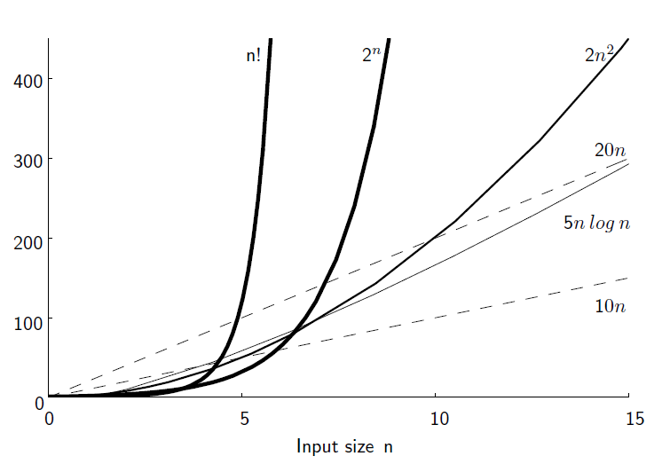
Growth of N
Notes:
The growth rate for an algorithm is the rate at which the cost of the algorithm
grows as the size of its input grows
A Faster computer or a faster algorithm?

Slide 33
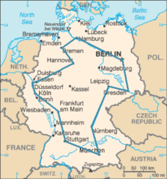
A Travelling Salesman problem
An optimal travelling salesperson tour through Germany’s 15 largest cities. It is the shortest among 43,589,145,600 possible tours visiting each city exactly once.

Slide 34
Some common Big-O Notations
Big O Notation | Name | Example scenario
O(1) | Constant | Determining if a number is even or odd; using a constant-size lookup table or hash table
O (log(n)) | Log | Binary search
O(n) | Linear | Finding an item in an unsorted list
O(n2) | Quadratic | Bubble sort
O(Cn) | Exponential | Travelling salesman problem using DP
O(n!) | Factorial | Travelling salesman problem using brute force

Slide 35
idea behind asymptotic notation
By removing the constants (variables that have a fixed but unknown value), we can focus on the part of the measure that grows and derive a simplified asymptotic bound on the algorithm.
A common notation that removes constants is called Big O Notation, where the O means “order of” (there are variants that do something similar that we'll look at shortly).
void f ( int a[], int n ) {
int i;
printf ( "N = %d\n", n );
for ( i = 0; i < n; i++ ) {
printf ( "%d ", a[i] );
}
printf ( "\n" );
}
The only part that takes longer as the size of the array grows is the loop.
So, the two printf calls outside of the loop are said to have a constant time complexity, or O(1), as they don't rely on N.
The loop itself has a number of steps equal to the size of the array, so we can say that the loop has a linear time complexity, or O(N). The entire function f has a time complexity of 2 * O(1) + O(N), and because constants are removed, it's simplified to O(1) + O(N).

Slide 36
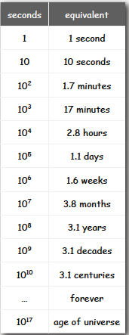
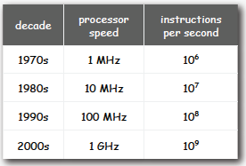
How long to process?

Slide 37
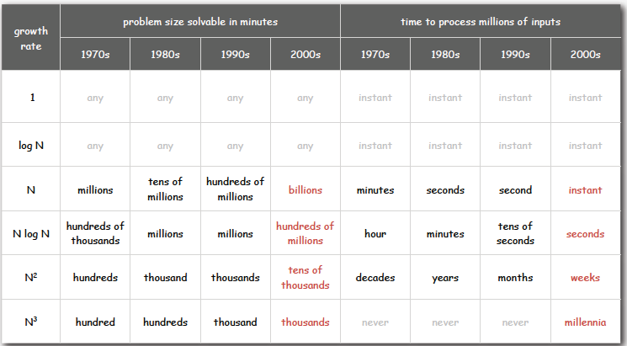
Practical insights into order of growth!

Slide 38
Some Math…
Summations Series
Log / exponents
Log_{b}(xy) = log_{b}x + log_{b}y
Log_{b}(x/y) = log_{b}x – log_{b}y
Log_{b}(xa) = alog_{b}x
Log_{b}a = log_{x}a / log_{x}b
Basic Probability

Slide 39
Some Math…
properties of logarithms:
log_{b}(xy) = log_{b}x + log_{b}y
log_{b} (x/y) = log_{b}x - log_{b}y
log_{b}xa = alog_{b}x
log_{b}a= log_{x}a/log_{x}b
properties of exponentials:
a^{(b+c)} = a^{b}a ^{c}
a^{bc} = (a^{b})^{c}
a^{b} /a^{c} = a^{(b-c)}
b = a ^{log}_{a}^{b}
b^{c} = a ^{c*log}_{a}^{b}

Slide 40
Important Series
Sum of squares:
Sum of exponents:
Geometric series:
Special case when A = 2
2⁰ + 2¹ + 2² + … + 2^{N} = 2^{N+1} - 1

Slide 41
Some examples of algos
Find LCM of numbers
Find shortest path on a map
Finding the meaning of a word in dictionary
Diagnose a disease in a report

Slide 42
Framework for algo analysis
Arithmetic and logic operations
Jumps
Loops
Pointer instructions
Arrays

Slide 43
Extras

Slide 44
Example of Chess Board – if coins are put …
Last square would be 2 power 64
Stack so high (approx 37 million KMS high) that it will cover the distance to the nearest star from the earth
Polynomial time and Exponential time
Polynomial is CN^{k}
Exponential is 2^{n}
Factorial is greater than 2^{N}
NP – Nondeterministic polynomial
Computation for NP is not complex but a number of sequential steps are required to be carried out for solving the problem

Slide 45
Summary
Review

Slide 46
Importance of Algorithms
impact is broad and far-reaching.
Old roots, new opportunities
Hadoop, page ranking, etc.
To solve problems that could not otherwise be addressed
For intellectual stimulation
Contests, new research
To become a proficient programmer.
They may unlock the secrets of life and of the universe.
For fun and profit
A lot of companies thrive on algorithms

Slide 47
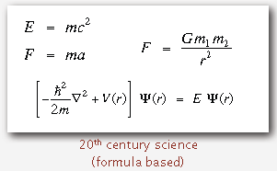
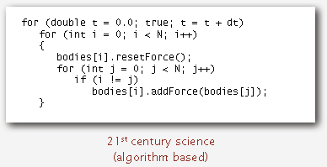
Why Study Algorithms?
They may unlock the secrets of life and of the universe
Computational models are replacing math models in scientific inquiry
“ Algorithms: a common language for nature, human, and computer. ” — Avi Wigderson

Slide 48
Why Study Algorithms & Data Structures?
“Algorithms + Data Structures = Programs.” — Niklaus Wirth
“I will, in fact, claim that the difference between a bad programmer and a good one is whether he considers his code or his data structures more important. Bad programmers worry about the code. Good programmers worry about data structures and their relationships.” — Linus Torvalds (creator of Linux)

Slide 49

Companies that thrive on Alogrithms

Slide 50
Asymptotic Notations
Asymptotic performance: How does algorithm behave as the problem size gets very large?
Running time
Memory/storage requirements
A way to describe behavior of functions in the limit
Abstracts away low-order terms and constant factors
How we indicate running times of algorithms
Describe the running time of an algorithm as n grows to ∝
O notation:
Ω notation:
Θ notation:

Slide 51
Properties of Big-Oh
If f(n) is O(g(n)) then af(n) is O(g(n)) for any a.
If f(n) is O(g(n)) and h(n) is O(g’(n)) then f(n)+h(n) is O(g(n)+g’(n))
If f(n) is O(g(n)) and h(n) is O(g’(n)) then f(n)h(n) is O(g(n)g’(n))
If f(n) is O(g(n)) and g(n) is O(h(n)) then f(n) is O(h(n))
If f(n) is a polynomial of degree d , then f(n) is O(n^{d})
n^{x} = O(a^{n}), for any fixed x > 0 and a > 1
An algorithm of order n to a certain power is better than an algorithm of order a ( > 1) to the power of n
log n^{x} is O(log n), fox x > 0 – how?
log ^{x} n is O(n^{y}) for x > 0 and y > 0
An algorithm of order log n (to a certain power) is better than an algorithm of n raised to a power y.

Slide 52
“Relatives” of Big-Oh
“Relatives” of the Big-Oh
Ω (f(n)): Big Omega – asymptotic lower bound
Θ (f(n)): Big Theta – asymptotic tight bound
Big-Omega – think of it as the inverse of O(n)
g(n) is Ω (f(n)) if f(n) is O(g(n))
Big-Theta – combine both Big-Oh and Big-Omega
f(n) is Θ (g(n)) if f(n) is O(g(n)) and g(n) is Ω (f(n))
Make the difference:
3n+3 is O(n) and is Θ (n)
3n+3 is O(n²) but is not Θ (n²)

Slide 53
More “relatives”
Little-oh – f(n) is o(g(n)) if for any c>0 there is n0 such that f(n) < c(g(n)) for n > n0.
Little-omega
Little-theta
2n+3 is o(n²)
2n + 3 is o(n) ?

